Slide 1

VISVESVARAYA TECHNOLOGICAL UNIVERSITY JNANA SANGAMA BELAGAVI-590018 SOCIAL CONNECT AND RESPONSIBILITIES(BSCK3O7)
Under the guidance of
Mr. MANIKANTA K
ASSISTANCE PROFESSOR,
DEPARTMENT OF COMPUTER SCIENCE ENGINEERING
M S ENGINEERING COLLEGE

Slide 2
SOCIAL CONNECT AND RESPONSIBILITIES
BY-
POORNIKA R 1ME24CS054
SPANDANA B 1ME24CS085

Slide 3

PLANTATION AND ADOPTION OF TREE

Slide 4

ROSES
Roses are among the most popular and beloved flowering plants in the world.
They have been cultivated for thousands of years, admired for their stunning
blooms, enchanting fragrance, and rich symbolism.
Scientific name:Genus Rosa
Family: Rosaceae
Kingdom: Plantae
Order: Rosales

Slide 5
INTRODUCTION
Roses (genus Rosa) are among the most popular and beloved flowering plants in
the world. They have been cultivated for thousands of years, admired for their
stunning blooms, enchanting fragrance, and rich symbolism. Roses are not only
significant in horticulture but also play essential roles in culinary, medicinal, and
cultural contexts. This report aims to provide a comprehensive overview of the
rose plant, detailing its description, properties, uses, and cultural significance.

Slide 6
LEAVES
Roses are perennial shrubs that can vary greatly in size and shape. They typically
feature:
Leaves
Roses have compound leaves, usually consisting of 5 to 9 leaflets. The leaves are:
Shape: Oval with serrated edges.
Color: Glossy green,sometimes with a reddish hue when young.
Texture: Smooth orslightly hairy, depending on the variety.

Slide 7
STEM
Stems
• Structure: Sturdy and woody, providing support for the plant.
• Thorns: Most roses have thorns or prickles along the stems, which serve as
a natural defense mechanism against herbivores.

Slide 8
FLOWERS
Flowers
Roses are famous for their diverse and beautiful blooms:
• Petal Arrangement: Petals can range from single to fully double layers,
creating a variety of forms.
• Colors: Available in nearly every color imaginable, including red, pink,
yellow, white, orange, and even blue or green in certain hybrid varieties.
• Fragrance: Many roses are highly fragrant, with scents ranging from sweet
and floral to rich and spicy. The aroma comes from volatile compounds
present in the petals.

Slide 9
HABITAT AND CULTIVATION
Roses prefer well-draining soil rich in organic matter. They thrive in full sunlight,
requiring 6 to 8 hours of direct sunlight each day. Here are some key cultivation
aspects:
Soil Requirements
• pH Level: Ideally between 6.0 and 6.8.
• Drainage: Good drainage is crucial to prevent root rot; heavy clay soils
may need to be amended with compost or sand.

Slide 10
COMMON SPECIES
1. Rosa rubiginosa: Also known as sweet briar rose, it is noted for its
fragrant foliage and can be found in wild habitats across Europe and Asia.
2. Rosa gallica: Known as the gallica rose, it has historical significance in
gardens and is often used in traditional rose breeding.
3. Rosa damascena: Commonly referred to as the damask rose, it is highly
valued for its essential oils and is widely used in the perfume industry.

Slide 11
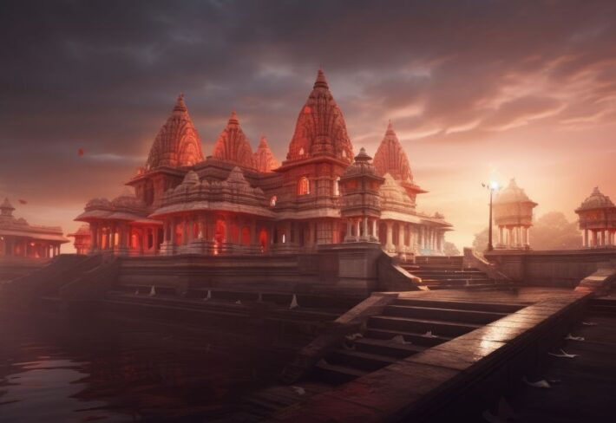
HERITAGE WALK AND CRAFTS CORNER

Slide 12
CHENNAKESHAVA TEMPLE
The Chennakeshava Temple, located in Somanathapura, Karnataka, is one of
the finest examples of Hoysala architecture and a UNESCO World Heritage
site. Built in 1268 CE during the reign of the Hoysala king Narasimha III, this
temple was constructed under the patronage of Somanatha, a general in the
Hoysala army, after whom the town of Somanathapura is named. Dedicated to
Lord Vishnu, the temple is a testament to the skill and devotion of the Hoysala
craftsmen.

Slide 13
ARCHITECTURAL SIGNIFICANCE
The Chennakeshava Temple is renowned for its unique Hoysala architecture, a style that flourished in the 12th and 13th centuries in Karnataka.
The temple is designed in a star-shaped plan, characteristic of Hoysala temples, which gives it an intricate and captivating form.
The temple stands on a raised platform and follows the trikutachala style, consisting of three shrines dedicated to different
forms of Vishnu: Keshava, Janardhana, and Venugopala.

Slide 14
Three shrines
The temple’s three sanctums are dedicated to three forms of Vishnu, and each sanctum contains a statue of Vishnu in various forms:
1. Chennakeshava : The main deity, an idol of Lord Vishnu with a serene,
beautiful expression, standing in a typical Hoysala style.
2. Venugopala : Another form of Vishnu depicted holding a flute, symbolic
of his incarnation as the shepherd Krishna.
3. Keshava : A third form of Vishnu, often shown with attributes such as a
conch and discus.

Slide 15
CULTURAL AND RELIGIOUS IMPORTANCE
Cultural and Religious Importance :
The Chennakeshava Temple is not just an architectural marvel but also a
living symbol of the religious and cultural heritage of the Hoysala Empire.
The temple continues to serve as an important pilgrimage site for Hindus, particularly followers of the Vaishnavism tradition. Its artistry and spiritual
significance draw visitors from around the world.
The temple’s significance extends beyond religion, as it reflects the zenith of
Hoysala art, architecture, and culture during the 13th century. It is a testament
to the artistic, cultural, and intellectual achievements of the Hoysala dynasty.

Slide 16
CONCLUSION
The use of soapstone, the triple-shrine design, and the vast array of
mythological sculptures are indicative of a highly evolved understanding of
both form and function. Moreover, the Chennakeshava Temple’s sculptural
richness provides invaluable insight into the spiritual, social, and artistic life of
the 13th-century Hoysala period.

Slide 17
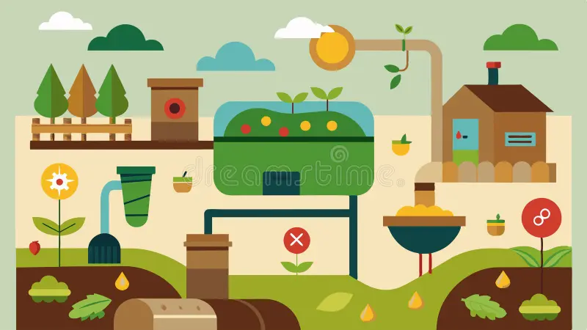
ORGANIC FARMING AND WASTE MANAGEMENT

Slide 18
INTRODUCTION
On 3—5 3une, the Global Landscapes Forum (GLF) achieved the first environmental
digital knowledge commons of its kind at the GLF Bonn Digital Conference.
• Nearly 5,000 participantsjoined from 146 countries and 6 continentsto
discuss how to rebuild the planet's food systems after the coronavirus
pandemic. The numbers
— 300 speakers, hundreds of organizations, 235,000 engagements on social,
22,000 messages plus 2,500 articles exchanged amongst participants —
highlighted the need for platformslike GLF to grow and continue including the
voices of diverse knowledge holders from every corner of the world

Slide 19
Although the earth is rich in water, only one percent is liquid fresh
water, the form werequire for our highest priority needs. The
demands on this liquid fresh water are growing, and many scientists
feel that a future shortage of fresh water will be eminent. Water
conservation and
. management emphasizes water quality protection, a growingarea of
employment and environmental concern.
. Water conservation and management encompasses the policies,
strategies and activities made to manage water as a sustainable
resource, to protect the water environment, and to meet current and
future

Slide 20
Water Conservation & Management (WCM) is a collaborated publishing projectunder VOLKSON PRESS and Zibeline International
water isused. Factors such as climate change will increase pressures on
natural water resources especially in industrial and agriculture.
Better water conservation and management has economic benefits and
helps protectthe environment. The more water you use, the more you

Slide 21
OBJECTIVE
”Water conservation and management welcomes original contributions that
potentiallyinvolve multidisciplinary research and considers sustainable
management and conservation of water as a valuable resource.
*“ Contributions should have relevance and implication on sustainable water
conservation practices from individual household to community level, as well
as fromregional, national and international scales. Journal publishes original
research papers,critical and comprehensive reviews, analyses and case studies
on topics, which include but are not limited to:

Slide 22
IMPORTANCE OF WATER CONSERVATION
Water is a resource . The current water supply on Earth comes from surface water
runoh, groundwater, and snow. This supply comes from the same sources that have
been used for thousands of years, which is threatened by overdevelopment, pollution,
and global warming. Only three percent of the Earth's water supply is made up of
freshwater, with only half a percent of that available for human consumption

Slide 23
WATER SCARCITY
Population Growth: The world's growing population putssignificant pressure on water
resources, leading to increased demand for domestic use, agriculture, and industrial
activities. Meeting the water needs of a growing population becomes amajor challenge.
2.Climate Change: Climate change exacerbates waterscarcity by altering precipitation
patterns, causing droughts, and affecting the availability of water resources. Erratic
weather
patterns and more frequent and severe droughts intensify the waterstress faced by many
regions.

Slide 24
RAIN WATER HARVESTING
Rainwater Harvesting Rainwater harvesting systems can vary from the basic small ones, like the attachment of a water butt to a rainwater down-pipe, to the complexly designed large ones like those which collect rainwaterfrom large areas and serve momentous numbers of properties. When it comes to
domestic purposes, these systems are relevant to both commercial and domestic properties.
When collected,rainwater can be used for garden irrigation, toilet flushing, and even in
washing machines.

Slide 25
CONCLUSION
In conclusion, controlling water pollution is a global challenge that requires a collaborative
approach from governments, industries, communities, and individuals. By taking stepsto
reduce water pollution, we can ensure that waterremains a safe and sustainable resource
for generationsto come. we can contribute to a more resilient and sustainable society while
also saving money on our water bills. It is essentialthat we alltake responsibility and make
a concerted effort to conserve water in our daily lives.

Slide 26
SOUTH INDIAN CUISINE
Southern Indian cuisine is not typically found on many Indian restaurant menus and
differs greatly from other regions. Its "curries" contrast differently in their textures and
can typically be categorized according to the drier consistency, or those favoring a
more soupy or stew-like presentation. Poriyals, dry curries consisting of a variety of
vegetables and spices, accompany rice dishes. Sambars, rasams, and kootus, three
common stew-like dishes, each differ in their primary ingredients and degrees of
liquidity. Sambars are essentially tamarind flavored pea and vegetable stews that are more watery than curries from other regions, but are thicker
than rasams

Slide 27
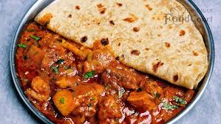
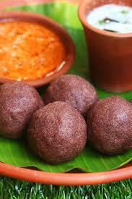
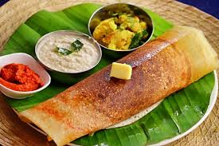
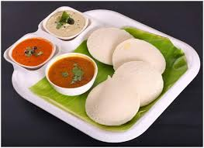
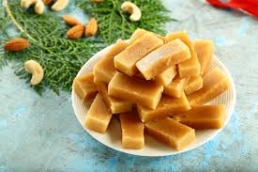
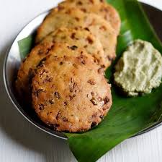
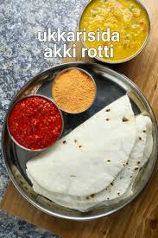
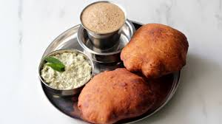
FAMOUS DISHES IN KARNATAKA
1. Rotti chiken curry
2.Ragi Mudde
3. Mysore Masala Dosa
4. Neer Dosa
5. Idli
6. Mysore Pak
7. Maddur Vada
8.Akki Rotti
9.Kesari Bath
10.Chiroti
11. Thatte Idli
12. Mangalore Buns
13. Kane Rawa Fry
14.Goli Baje

Slide 28
HEALTH BENEFITS OF MYSORE PAK
Rich in Protein: Gram flour is relatively high in protein compared to other flours, making it a good source of plant-based protein.
Gluten-Free: Gram flour is naturally gluten-free, making Mysore Pak suitable for those with gluten sensitivities or celiac disease.
Rich in Vitamins and Minerals: Gram flour contains various vitamins and minerals,including B vitamins, iron, magnesium, and phosphorus.
High in Dietary Fiber: Gram flour is rich in dietary fiber, which canaid indigestion and promote a feeling of fullness.

Slide 29
CONCLUSION
Tourism as an industry deals with the socio-economic and cultural
wonders of a destination, motivating people to travel to different places,
states, and countries away from their usual place of residence. This
movement of people may be categorized into travellers, tourists, and
excursionists who are involved in some kind of activity implying tourism
expenditure.The current study relates to the role of Food Tours in
promoting the local food of a place, here, specifically Shimla. The study
focuses on examining three objectives.

